Slide 1
Accessing the Cloud
Web Browsers :
To connect to the cloud, most likely you and your users will utilize a web browser. Which one should you use?
Internet Explorer enjoys the highest market share of browser usage—69.77 percent (according to a December 2008 study released by the web metrics firm Net Applications).
You can attribute that dominance to the fact that Internet Explorer is included with Windows, the dominant operating system in the world.
Mozilla’s Firefox accounts for 20.78 percent, Apple’s Safari represents 7.13 percent, while Google Chrome accounts for less than 1 percent of the market at .98 percent.
The remaining almost 2 percent of browsers include products like Camino, Opera, and others. Of course these numbers are moving targets, but the market shares have been more or less the same over the months.

Slide 2
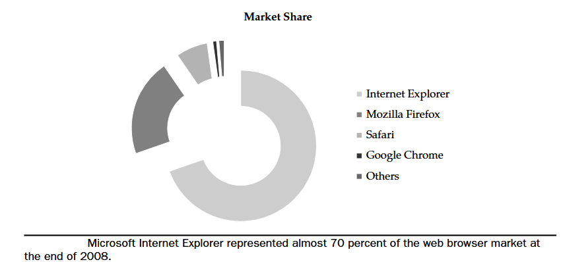
Accessing the Cloud

Slide 3
Accessing the Cloud
Internet Explorer :
Windows Internet Explorer 8 for Windows Vista, XP, and Windows 7 is the latest version of the popular web browser.
IE 8 Features
Internet Explorer 8 delivered a new look and enhanced capabilities that made everyday tasks—such as searching, browsing multiple sites, and printing—simple and fast.
The big change in IE 8 is its rendering modes. The progressive evolution of the Web has necessitated that browsers such as Internet Explorer include multiple content-rendering modes both supporting strict interpretation of certain web standards and also supporting behaviors designed to maintain compatibility with existing web sites.
Web site designers generally have the ability to specify which mode they are designing for; in the absence of specific instructions from a web site, browsers are preset to use one of the modes by default.
Internet Explorer 8 has been designed to include three rendering modes: One that reflects Microsoft’s implementation of current web standards.
A second reflecting Microsoft’s implementation of web standards at the time of the release of Internet Explorer 7 in 2006 A third based on rendering methods dating back to the early Web

Slide 4
Accessing the Cloud
The newest rendering mode is forward-looking and preferred by web designers, while the others are present to enable compatibility with the myriad sites across the Web that are currently optimized for previous versions of Internet Explorer.
Internet Explorer 8 includes important end-user advancements, it was also designed with developers and IT managers in mind.
Microsoft engineered Internet Explorer 8 for compatibility with existing web sites by adhering to some of the most important standards for web site development.
Internet Explorer 8 also features improved manageability for enterprises through the enhanced support of Active Directory Group Policy.
It enables IT managers to easily deploy and centrally manage the browser on each of the desktops in their network.

Slide 5
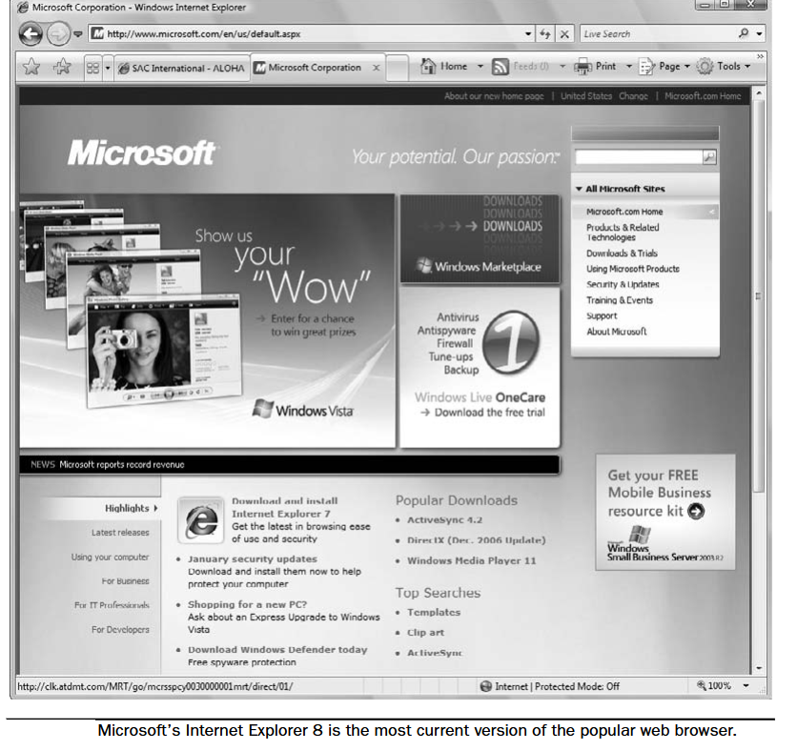
Accessing the Cloud

Slide 6
Accessing the Cloud
Firefox :
In June 2008 Mozilla released Firefox 3, a major update to its popular, free, open-source web browser. Firefox 3 is the culmination of three years of efforts from thousands of developers, security experts,localization and support communities, and testers from around the globe.
Available in approximately 50 languages, Firefox 3 is two to three times faster than its predecessor and offers more than 15,000 improvements, including the revolutionary smart location bar, malware protection, and extensive under-the-hood work to improve the speed and performance of the browser.
User Experience :
The enhancements to Firefox 3, smart location bar, affectionately known as the “Awesome Bar.” It learns as people use it, adapting to user preferences and offering better-fitting matches over time.
The Firefox 3 Library archives browsing history, bookmarks, and tags, where they can be easily searched and organized.
One-click bookmarking and tagging make it easy to remember, search, and organize web sites. The new full-page zoom displays any part of a web page, up close and readable, in seconds.

Slide 7
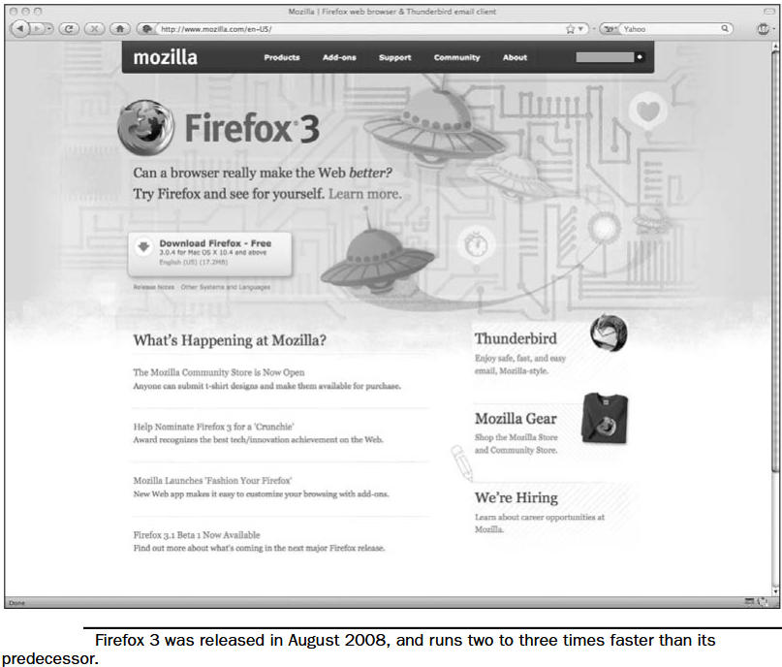
Accessing the Cloud

Slide 8
Accessing the Cloud
Firefox Performance :
Firefox 3 is built on top of the Gecko 1.9 platform, resulting in a safer, easier-to-use, and more personal product. Firefox 3 uses less memory while it’s running than previous releases, and its redesigned page rendering and layout engine means that users see web pages two to three times faster than with Firefox 2.
Security :
Firefox 3 raises the bar for security. The new malware and phishing protection helps protect from viruses, worms, trojans, and spyware to keep people safe on the Web.
Firefox 3’s one-click site ID information allows users to verify that a site is what it claims to be. Mozilla’s open-source process leverages the experience of thousands of security experts around the globe.
Customization :
Firefox 3 lets users customize their browser with more than 5,000 add-ons. Firefox add-ons allow users to manage tasks like participating in online auctions, uploading digital photos, seeing the weather forecasts, and listening to music, all from the convenience of the browser.
The new Add-ons Manager helps users to find and install add-ons directly from the browser.

Slide 9
Accessing the Cloud
Safari :
Apple claims that Safari 3.1 is the world’s fastest web browser for Mac and Windows PCs, loading web pages 1.9 times faster than Internet Explorer 7 and 1.7 times faster than Firefox 2.
Safari also runs JavaScript up to six times faster than other browsers, and is the first browser to support the latest innovative web standards needed to deliver the next generation of highly interactive Web 2.0 experiences. Safari 3.1 is available as a free download at www.apple.com/safari for both Mac OS X and Windows.
“Safari 3.1 for Mac and Windows is blazingly fast, easy to use and features an elegant user interface,” said Philip Schiller, Apple’s senior vice president of Worldwide Product Marketing. “And best of all, Safari supports the latest audio, video and animation standards for an industry-leading Web 2.0 experience.”
Safari Performance :
Safari features an intuitive browsing experience with drag-and-drop bookmarks, easy-to-organize tabs, an integrated Find capability that shows the number of matches in a page, and a built-in RSS reader to quickly scan the latest news and information.

Slide 10
Accessing the Cloud
Safari 3.1 is the first browser to support the new video and audio tags in HTML 5 and the first to support CSS Animations. Safari also supports CSS Web Fonts, giving designers limitless choices of fonts to create stunning new web sites.
System Requirements :
Safari 3.1 for Mac OS X requires Mac OS X Leopard or Mac OS X Tiger version 10.4.11 and a minimum of 256MB of memory and is designed to run on any Intel-based Mac or a Mac with a PowerPC G5, G4, or G3 processor and built-in FireWire.
Safari 3.1 for Windows requires Windows XP or Windows Vista, a minimum of 256MB of memory, and a system with at least a 500MHz Intel Pentium processor.

Slide 11
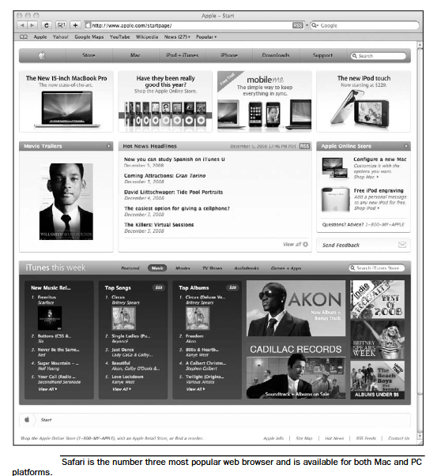
Accessing the Cloud

Slide 12
Accessing the Cloud
Chrome :
Chrome is Google’s foray into the open-source browser market. In the early days of the Internet, web pages were frequently little more than text.
The Web has evolved into a powerful platform that enables users to collaborate with friends and colleagues through email and other web applications, edit documents, watch videos, listen to music, manage finances, and much more.
Google Chrome was built for today’s Web and for the applications of tomorrow.
“We think of the browser as the window to the web—it’s a tool for users to interact with the web sites and applications they care about, and it’s important that we don’t get in the way of that experience,” said Sundar Pichai, vice president of product management, Google Inc.
“Just like the classic Google homepage, Google Chrome has a simple user interface with a sophisticated core to enable the modern web

Slide 13
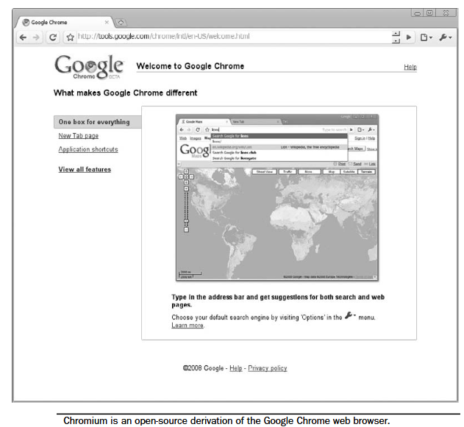
Accessing the Cloud

Slide 14
Accessing the Cloud
Chrome Features :
Google Chrome was designed to make it easy for users to search and navigate the Web for the content they’re looking for.
Features include
A combined search and address bar quickly takes users where they want to go.
When users open a new tab in Google Chrome, they’ll see a page that includes snapshots of their most-visited sites, recent searches, and bookmarks, making it easier to navigate the Web.
Each browser tab operates as a separate process; by isolating tabs, if one tab crashes or misbehaves, others remain stable and responsive, and users can continue working without having to restart Google Chrome.
Google also built a new JavaScript engine, V8, which not only speeds up today’s web applications, but enables a whole new class of web applications that couldn’t exist on today’s browsers.

Slide 15
Accessing the Cloud
Open Source :
“Google Chrome was built upon other open source projects that are making significant contributions to browser technology and have helped to spur competition and innovation.”
To further advance the openness of the Web, Google Chrome is being released as an open-source project under the name Chromium.
The intent is that Google will help make future browsers better by contributing the underlying technology in Google Chrome to the market, while continuing to develop additional features.
Chrome Cloud :
There’s a lot of buzz around Chrome being a great tool for cloud computing. It extends the cloud into your organization’s computer, and vice versa. This is mainly because of the power of the V8 JavaScript engine and built-in Google Gear.

Slide 16
Accessing the Cloud
Google Gears are also open source, and they enable powerful web applications by adding new features to the web browser. Major API components to Gears include
• A database module that can store data locally
• A WorkerPool module that provides parallel execution of JavaScript code
• A LocalServer module that caches and serves application resources (like HTML, JavaScript, images, and so on)
• A Desktop module that lets web applications interact more naturally with the desktop
• A Geolocation module that lets web applications detect the geographical location of their users

Slide 17
Accessing the Cloud
Chrome will allow desktop and web applications to merge, putting everything into the cloud so that you won’t even have to think about both terms.
Chrome is an application virtual machine for both on and offline web applications.
Google Chrome can be downloaded at www.google.com/chrome. Google Chrome for Mac and Linux users is still in the works.
Chromium, visit www.chromium.org.
There are a number of ways to connect to the cloud. The way you opt to do so will depend on a number of factors including your or your programmers’ skills, which computing platform you use, and what your vendor offers.

